Slide 1
CCH Tagetik & SAP HANA

Slide 2
CCH TAGETIK FOR SAP HANA
Observed Trends: SAP is forcing customers to migrate ERP systems to SAP S/4HANA:
    SAP ECC (ERP Central Component) 6.0 Mainstream Support Ends: December 31, 2027
    Extended Maintenance (Optional, at a premium cost): Until December 31, 2030
Common Challenges: After 2027, customers who have not migrated to SAP S/4HANA will either need to:
  Pay for extended maintenance (which is costly and only lasts until 2030), or
  Move to a Customer-Specific Maintenance model, which means no new features or regulatory updates, just security patches.
Perceived Risks: high migration costs, extended timelines and business disruptions impacting other integrated BI and CPM systems.
MARKET
INSIGHTS
Notes:
Observed Trends:
SAP is essentially forcing customers to migrate to SAP S/4HANA by setting firm deadlines for SAP ECC 6.0 end-of-support:
Mainstream support ends on December 31, 2027.
Extended maintenance will be available until December 31, 2030, but at a premium cost.
After that, the only option left will be Customer-Specific Maintenance, which only provides security patches and no new features or regulatory updates.
Common Challenges:
For companies that don’t migrate by 2027, they will have two options:
Pay for extended maintenance, which is costly and only buys them time until 2030.
Move to a Customer-Specific Maintenance model, but this means no innovation, feature updates, or regulatory compliance enhancements—only security patches.
This forces organizations to make a critical decision about their ERP strategy sooner rather than later.
Perceived Risks:
The cost and complexity of migrating to S/4HANA is significant, requiring major investment in resources and time.
Many companies are concerned about business disruptions, particularly regarding system downtime and the impact on daily operations.
There’s also a risk of integration challenges, as migrating to S/4HANA may disrupt existing BI and CPM systems, requiring reconfigurations or replacements.
Vendor lock-in is another consideration—once on S/4HANA, customers are fully committed to the SAP ecosystem with limited flexibility.
Closing Remarks:
This represents an opportunity for CCH Tagetik because our solution is the only CPM solution in the market that is certified to run natively on HANA,

Slide 3


Ready for SAP ECC, S/4 Cloud & On-premise and other SAP products for a natural continuation of your SAP investment
CCH Tagetik powered by SAP HANA is the only non-SAP EPM solution certified to run natively on SAP HANA highly benefitting from HANA In-memory data storage, data integration options & data processing optimization
FINANCE AUTOMATION AT HIGH PERFORMANCE
Optimized for fast cycles of massive data processing without latency leveraging SAP HANA In-Memory platform, parallel processing, Hot/Warm Data Tiering & compression
Reported Customer Improv.:
40% faster runs for complex output reports
70% faster Consolidation data processing
40% faster allocation data processing
REAL TIME DATA & METADATA INTEGRATION
By storing data directly in memory, SAP HANA enables lightning-fast data retrieval and real-time analytics, greatly reducing the time required for complex queries.
The CCH Tagetik SAP s/4HANA Connector provided dynamic integration of nearly all essential SAP data included FI/CO, EC-PCA (cost center), MM, SD (sales & dist), Classic SAP ERP (ECC, etc)
SAP PARTNERSHIP & CO-INNOVATION
5+ years of trusted partnership and co-innovation with SAP:
SAP HANA Licenses are bundled with CCH Tagetik licenses for TCO advantage
One vendor experience: CCH Tagetik is your only point of contact before and after the purchase
Notes:
CCH Tagetik is the only NON SAP solution that runs natively on SAP HANA. Unlike other vendors that merely INTEGRATE with SAP solutions running on HANA—which is now a baseline expectation for CPM solutions—CCH Tagetik not only does it integrate but it actually NATIVELY runs on HANA. And most import important, we are CERTIFIED to run on HANA by SAP.
What this means to you is that:
#1: CCH Tagetik is a natural Extension of your SAP Investment: Whether you're running ECC or S/4, or transitioning to SAP HANA through Central Finance or RISE, CCH Tagetik enables you to build on your existing SAP foundation. It enhances your financial and operational processes while delivering faster time to value than SAP's own EPM solutions.
#2: With CCH Tagetik running on HANA, our can take full advantage of SAP HANA’s in-memory database couple with CCH Tagetik's very own in memory capabilities for unparalleled speed and efficiency. The improvement in performance is real: We’re talking about 40% faster report runs, 70% faster consolidation, and 40% faster allocation processing—real improvements that directly impact your business operations.
.
#3: because of our native integration, CCH Tagetik seamlessly connects with your existing SAP ecosystem—whether it’s ECC, S/4, or others. With real-time data exchange and metadata integration, we reduce latency and complexity, enabling your team to work smarter and faster without having to juggle disconnected systems.
And of course, being a strong partner of SAP, the necessary HANA licenses to run CCH Tagetik on SAP HANA are bundled in our offering directly, giving you one vendor, one point of contact, and a completely unified experience from implementation to ongoing support.

Slide 4


CCH Tagetik connector for S/4HANA
Key features
CCH Tagetik Connector for S/4HANA
Connect your SAP ERP (S/4HANA) with CCH Tagetik
Embedded in CCH Platform for central governance and full user control
Easy deployment and interfacing through modern RESTful API (OData) or native HANA to HANA connectivity
Manual upload /
SFTP / TCDL
SAP ERP classic
CCH® Tagetik
Benefits
SAP DI
Pre-built business content for quick out-of-the-box integration of all master data and hierarchies
Lean approach without middleware requirement
(Near) real-time integration
Configured deployment to your specific needs
Possibility to include data from Central Finance
…
CCH Tagetik Standard or SAP HANA Platform
Notes:
CCH Tagetik has developed a specific connector for S/4HANA:
In this slide, we will discuss how the CCH Tagetik Connector for S/4HANA enables seamless integration between SAP S/4HANA and CCH Tagetik, ensuring a smooth flow of financial and operational data.
This integration is crucial for organizations transitioning to SAP S/4HANA, as it supports real-time data synchronization, governance, and automation in financial processes.
How the Connector Works
On the left, we see the SAP S/4HANA architecture, which includes various data transfer methods such as manual uploads, SFTP, TCDL, SAP ERP Classic, and SAP Data Integration (SAP DI).
The CCH Tagetik Connector for S/4HANA acts as a bridge between SAP S/4HANA and CCH Tagetik, facilitating real-time data flow and governance.
The data from S/4HANA is transferred into CCH Tagetik Standard or SAP HANA Platform, ensuring accurate and up-to-date financial consolidation, planning, and reporting.
Key Features
The connector seamlessly links SAP ERP (S/4HANA) with CCH Tagetik, enabling a direct connection for financial processes.
It is embedded within the CCH Platform, providing central governance and user control over financial data.
Deployment is simple, leveraging SAP Fiori (OData) for interfacing or a direct HANA-to-HANA connection for high-performance data exchange.
Benefits
Comes with pre-built business content, allowing for out-of-the-box integration of master data and hierarchies, reducing implementation time.
Lean architecture means there is no need for middleware, making deployment easier and reducing system complexity.
Supports (near) real-time data integration, ensuring financial data is always current and aligned with the ERP system.
Can be configured to meet specific business needs, providing flexibility in data governance and reporting structures.
Includes the option to incorporate data from Central Finance, which is critical for companies using SAP's centralized financial consolidation features.
Closing Remarks
The CCH Tagetik Connector for S/4HANA is a powerful tool for organizations looking to streamline financial processes within the SAP S/4HANA ecosystem.
It ensures real-time, accurate, and governed data exchange, helping finance teams focus on analysis, forecasting, and decision-making, rather than manual data handling.
This solution is particularly valuable for companies transitioning to SAP S/4HANA, as it reduces complexity, enhances data accuracy, and ensures a seamless financial transformation.

Slide 5
CCH® Tagetik SAP S/4HANA Connector
CCH® Tagetik SAP S/4HANA Connector provides dynamic integration of nearly all your essential SAP data with flexible customization based on a modular offering
Integration Modules
Master Data
Hierarchies
Transactional data
Company code
General ledger and group accounts
Cost center/Cost types
Profit center
Products
…
Company code hierarchies
Account hierarchies
Cost center groups
Cost types groups
Profit center groups
Product hierarchies
…
Classic SAP ERP
  old General Ledger
  new General
  EC-PCA (cost center)
  SAP SD (sales & dist.)
SAP S/4 HANA Simple Finance
…
Notes:
Our comnnector is not only for DATA but metadata as well, including dimensions such as Company Code, Accounts, Cost Centers, etc and all related hierarchies.
This means that if a new GL account gets added into S/4HANA, that element will flow directly into Tagteik with no manual intervention.

Slide 6
SAP S/4HANA Tables that
CCH® Tagetik SAP Connector can integrate with
# | Table Code | Description | Area | Module
1 | ACDOCA | Universal Journal Entry Line Items | P&L Actual / Balance | FI/CO
3 | ACDOCP | Plan Data Line Items | P&L Plan | FI/CO
4 | AUFK | Order Master Data/ Production Planning | Internal Orders | FI/CO
5 | CEPC | Profit Center Master Data | Profit Center | EC-PCA
6 | CEPCT | Profit Center Master Data Texts | Profit Center | EC-PCA
7 | COOI | Commitments Management: Line Items | Overhead Cost Orders | FI/CO
8 | CSKA | Cost Elements (Data Dependent on Chart of Accounts) | G/L accounts/cost elements | FI/CO
9 | CSKB | Cost Elements (Data Dependent on Controlling Area) | G/L accounts/cost elements | FI/CO
10 | CSKS | Cost Center Master Data | Cost Centers | FI/CO
11 | CSKT | Cost Center Master Data Texts | Cost Centers | FI/CO
12 | CSKU | Cost Element Texts | G/L accounts/cost elements | FI/CO
13 | GLPCA | EC-PCA: Actual Line Items | P&L Actual | EC-PCA
14 | GLPCP | EC-PCA: Plan Line Items | P&L Plan | EC-PCA
15 | GLT0 | G/L account master record transaction figures | Balance | FI/CO
16 | MAKT | Material Descriptions / Materials Management | Materials/Articles | MM
17 | MARA | General Material Data / Materials Management | Materials/Articles | MM
18 | MVKE | Sales Data for Materials | Materials/Articles | SD
19 | SETHEADER | All Hierarchies | Hierarchies (all) | General
20 | SETHEADERT | All Hierarchies | Hierarchies (all) | General
21 | SETLEAF | All Hierarchies | Hierarchies (all) | General
22 | SETNODE | All Hierarchies | Hierarchies (all) | General
23 | SKA1 | G/L Account Master (Chart of Accounts) | G/L accounts/cost elements | FI/CO
24 | SKAT | G/L Account Texts | G/L accounts/cost elements | FI/CO
25 | SKB1 | G/L Account Master (Company code) | G/L accounts/cost elements | FI/CO
26 | T001 | Company codes | Company codes | FI/CO
27 | T179 | Materials Products Hierarchies / Materials Management | Hierarchies (all) | MM
28 | T179TCO | Materials Products Hierarchies Text / Materials Management | Hierarchies (all) | MM
29 | TCURR | Exchange rates | Currency Rates | FI/CO
30 | VBRK | Billing Document: Header Data | Sales and Distribution | SD
31 | VBRP | Billing Document: Item Data | Sales and Distribution | SD
Notes:
These are some of the SAP HANA tables that our connector integrates natively with.

Slide 7













































































CCH® Tagetik powered by HANA
Certified HANA partner
Built-in S/4 integration
Co-innovation member
7
Notes:
This is just a glimpse of the diverse range of customers leveraging CCH Tagetik on SAP HANA, each with unique needs and goals:
SAP centric organizations that want to continue with their SAP-first strategy like Lyndtt, Milliken or HF Sinclair
Customers that are on Central Finance or on their way to s/4 that want a future proof CPM solution like Rio Tinto
Customers that simply wanted a boost in performance given teir data volumes like Principal Financials, Milwaukee Tool and Southern California Edison
These examples demonstrate the versatility and value of CCH Tagetik on SAP HANA in addressing diverse challenges across industries, from aligning with SAP ecosystems to enhancing performance and scalability.

Slide 8
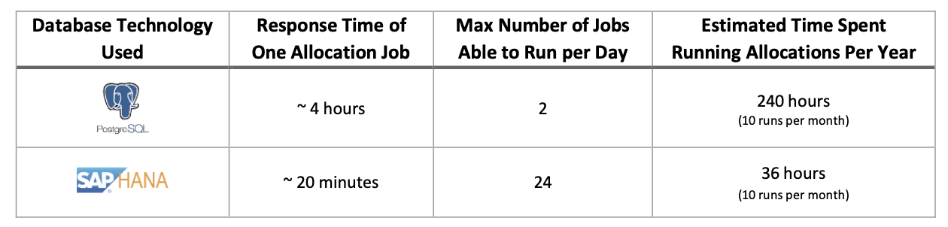
Use Case:
CCH Tagetik Module: Allocations & Reporting
Cloud Deployment: Enterprise (Private Cloud)
Database Type: PostgreSQL --> SAP HAA
The analysis was conducted to evaluate whether customer response times could be improved by adopting a different database technology and storage approach, especially with future phases requiring higher data processing.
Proposed Solution: Moving the current Franklin Templeton production environment to CCH Tagetik Powered by SAP HANA.
Tests Performed: The stress test was conducted on both PostgreSQL and SAP HANA infrastructures to compare the performance in processing a CCH® Tagetik Allocation Job (Task CLOSING), which is part of the CCH Tagetik workflow (WF_ALLOC_TCO).
Franklin Templeton achieves massive improvement in performance with CCH Tagetik on HANA
Notes:
By moving to SAP HANA, Franklin Templeton (Fin. Services Holding company, 1.3T in AUM based in California) achieved a massive improvement in performance especially around allocation data processing and report response time.
Given the compelxity of their allocation rules, Franklin Templeton faced a significant challenge in improving the performance and scalability of their financial processes, particularly as their data processing needs continued to grow.
Their existing PostgreSQL-based infrastructure for CCH Tagetik Allocations and Reporting was becoming a bottleneck, with response times and job capacity limiting efficiency and overall throughput. To address this, they conducted an analysis to determine whether moving to a SAP HANA-based environment could significantly enhance performance.
The proposed solution involved migrating Franklin Templeton’s production environment to CCH Tagetik Powered by SAP HANA. This shift promised not only faster response times but also the ability to handle larger data volumes and more complex processes, particularly with future requirements in mind.
The results of the migration were transformative. In stress tests comparing PostgreSQL and SAP HANA infrastructures:
Response times for a single allocation job were reduced from 4 hours to approximately 20 minutes.
The number of allocation jobs able to run per day increased from 2 to 24.
Estimated time spent running allocations per year dropped dramatically from 240 hours to just 36 hours—a savings of over 200 hours annually.

Slide 9
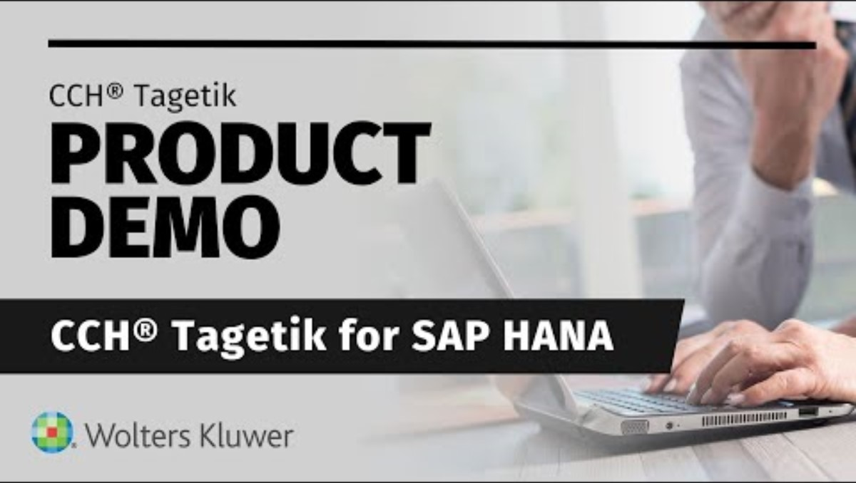
Quick Demo:
CCH Tagetik for SAP HANA Drill Through Demo

Slide 10






Benefits of CCH Tagetik on SAP HANA
For Finance:
For IT:
High performance CPM
Fast cycles with no latency with CCH Tagetik on SAP HANA In-Memory platform
Continuation of SAP Investment
Ensures technological alignment with SAP strategy and investment
Real-time data access
Direct connection to SAP Source systems for financial & non-financial data
Built-in SAP Connector
Pre-built connectors reducing integration cost by 30%+ (SDI+SDA)
Data Volume ready
Granular operational data and high- performance engine based on SAP technology
Future Proof / Natively runs on HANA
Ready to run on SAP HANA and integrate SAP products
NO EXTRA FEES FOR EXTRACING DATA FROM SAP
Notes:
CCH Tagetik powered by SAP HANA brings benefits to both Finance & IT Professionals.
For Finance:
High-performance CPM
With CCH Tagetik on SAP HANA's in-memory platform, finance teams can execute fast cycles with no latency, ensuring quicker decision-making and real-time insights into business performance. Performance improvements has been demonstrated to be up to 70% in the case of heavy data processing calculations such as consolidation and allocations.
Real-time data access
The solution enables direct connectivity to SAP source systems, providing seamless access to both financial and non-financial data. This empowers finance teams to build comprehensive, integrated financial models without delays or manual data handling.
Data volume readiness
Thanks to the scalability of SAP HANA technology, CCH Tagetik is equipped to handle large volumes of granular operational data. This capability is essential for organizations managing extensive datasets while maintaining high performance.
For IT:
Continuation of SAP investment
By running on SAP HANA, this solution aligns seamlessly with your organization’s existing SAP strategy and technology roadmap, ensuring your SAP investments remain future-proof.
Built-in SAP connectors
The pre-built connectors significantly simplify integration processes and reduce costs by over 30%. These connectors, powered by SDI and SDA technology, eliminate the need for extensive custom development.
Native HANA compatibility
CCH Tagetik is natively designed to run on SAP HANA, allowing it to integrate effortlessly with SAP products. This ensures IT teams can implement and maintain the system with minimal disruption to existing SAP infrastructure.
The most important aspecy of it all however is with CCH Tagetik, organizations running on SAP will not be subject to fees and charges imposed by SAP foe extracting data to other systems. SAP infact has shifted to a model where data extraction from its systems to non-SAP applications is subject to licensing fees. This means if a company wants to pull data from SAP and use it in third-party analytics tools, reporting platforms, or other business applications, they may have to pay additional fees. This is commonly referred to as "Indirect Access" or "Digital Access" licensing. With CCH Tagetik being certified to run on HANA, clients are not subject to such fees.

Slide 11
I would like a slide here on how to avoid those fees

Slide 12
Common Questions & Competitive FUD
Isn’t SAP a competitor of yours? Why would they partner with you?
Kind of—SAP is first and foremost an ERP company, and their primary focus is S/4HANA, where they make their money. Their goal is to sell and expand S/4HANA adoption, not to dominate the CPM space. In fact, if you look at their actions over the past few years, SAP has consistently deprioritized CPM, discontinuing solutions like SAP BPC and SAP FC and pushing customers toward third-party CPM vendors instead of developing their own. Their strategy is clear: focus on ERP and partner with best-of-breed solutions for CPM.. This is exactly why SAP welcomes partners like us. We enhance the value of S/4HANA, making it easier for customers to adopt and leverage their ERP investment. And if your company is running Oracle ERP, SAP actually prefers to see a solution like CCH Tagetik in your ecosystem rather than an Oracle CPM tool. By partnering with us, SAP can maintain and expand its presence in your organization rather than risk losing ground to Oracle’s full-stack offering.
Why would it make more sense to go with Tagetik for CPM than SAP’s own CPM Solution which is supposed to integrate better with the other SAP products coming from the same vendor?
Believe it or not, SAP’s own CPM solutions take longer to integrate into S/4HANA than CCH Tagetik. Customers transitioning to S/4HANA need fast time to value, and delays in integration can slow down financial processes, reporting, and decision-making. Additionally, SAP’s CPM offerings are not fully matured and still require significant customization, configuration, and effort to work effectively. Finally, CCH Tagetik provides an "all-in" platform approach to handle the broad scope of CFO business processes – SAP offers a suite of no less than 6 products to reach functional parity.

Slide 13
Competitive Comparison
All modern CPM applications can integrate with S/4. CCH Tagetik is the only non-SAP CPM tool certified to run natively on SAP HANA.
 | Data integration w/ S/4 HANA | Native Run on S/4 HANA
CCH Tagetik
SAP
Oracle
Onestream
Board
Anaplan
IBM

Slide 14
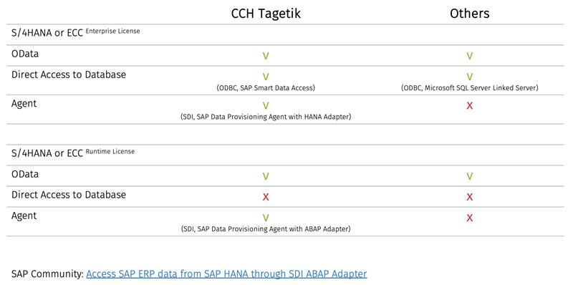
Is this accurate?
If customer is on HANA, can they bypass the SAP data extraction fees with us? If they are on ECC, are they subject to fees? Can we help them not pay those fees?
When you say in the forst rown s/4HANA or ECC, do you mean ECC on HANA or is this applicable to also ECC on Oracle?
This table is VERY powerful but it needs more explanation – they real differentiating is that with us, they can avoid SAP fees (hopefully) and we have to tell them which configuration allows us (us and us only) to do so!

Slide 15
Thank you

Slide 16





Selected customer projects and references for SAP Integration
DO NOT USE. NONE IS NA HERE
CCH Tagetik on SAP HANA on-premise
SAP S/4 HANA Finance incl. embedded BW
Microsoft PowerBI Dashboards
CCH Tagetik Enterprise Cloud powered SAP HANA
SAP ECC ERP classic
CCH Tagetik Enterprise Cloud powered SAP HANA
SAP S/4 HANA Finance
CCH Tagetik Enterprise Cloud powered SAP HANA
SAP ECC ERP to SAP S/4 HANA Finance
BW/4 HANA
CCH Tagetik on SAP HANA (on-premise)
SAP S/4 HANA Finance
BW/4 HANA
Integration use case
Monthly closing process required (near) real-time integration of FI/CO data
Enterprise management reporting in SAP BW and PowerBI with the need of backward integration of consolidated Tagetik data
High data volume (integration of up to 1 Billion records from SAP ERP to Tagetik AIH)
Deep integration to the planning process and cycle via workflows
Leveraging of native HANA to HANA interface for improved performance
Increased integration control through access via Tagetik user interface implementation
Full integration scope between SAP and Tagetik (upstream/downstream) of master data and transactional data
Central master data governance in SAP pushed to Tagetik
Full integration scope between SAP and Tagetik (upstream/downstream) of master data and transactional data
Central master data governance in SAP pushed to Tagetik
Challenges and benefits

Slide 17
CCH Tagetik for SAP HANA - Market & Messaging For Sales
MESSAGING
WHAT IS IT
HOW DOES IT HELP
Get the optimum speed for your CPM with CCH Tagetik for SAP HANA! To give you the ultimate in data processing performance, we’ve combined our market leading CPM platform with SAP HANA’s in-memory technology. What’s more, our S/4HANA Connector connects to any SAP database and all other source systems, so you can be confident you’re using a single source of validated data.
Extend your SAP investment. Harness the power of granular data. Lay a foundation for AI. Get prepared for the future — whatever it holds — with CCH Tagetik for SAP HANA.
Today’s SAP systems are all moving to the SAP HANA platform by 2027, 2030 with additional support costs. CCH Tagetik was the first CPM vendor to provide an SAP HANA platform certified by SAP.
CCH Tagetik optimized for the SAP HANA platform
SAP HANA in-memory database can process higher volumes of data faster than traditional databases
WHO TO SELL
WHEN TO SELL
Your key customer / new business contacts – Finance or IT
NOW, as customers / new business are looking to quickly switch all their SAP solutions to SAP HANA
KEY CAPABILITIES
OPTIMIZED DATABASE
UNIFIED PROCESSES
S/4HANA INTEGRATION
CCH Tagetik available on SAP HANA.
Financial close, planning, ESG & regulatory, and tax in one platform
Pre-built connector to S/4HANA and integration with other SAP systems.
KEY VALUE DIFFERENTIATORS
CERTIFIED BY SAP
CPM WITH SAP KX
FUTURE-PREPARED
CCH Tagetik is trusted solution, tested and certified by SAP
CCH Tagetik, known as the trusted SAP HANA provider
Be ready for the S/4HANA and SAP HANA revolution.

Slide 18
S/4HANA Connector - Market & Messaging For Sales
MESSAGING
WHAT IS IT
HOW DOES IT HELP
Get S/4HANA ready with CCH Tagetik! Our powerful pre-built S/4HANA connector gets you the data you need – when you need it!
Today’s SAP ERP systems are all moving to the S/4 HANA platform to 2027, 2030 with additional support costs. Out of 40K SAP customers – 29K still to be migrated. CCH Tagetik was the first CPM vendor to provide an SAP HANA platform certified by SAP.
Now CCH Tagetik is once again a trusted leader with the prebuilt connector to S/4HANA to integrate all your key ERP data.
Available for use with both standard and SAP HANA platforms, CCH Tagetik ensures you can accelerate your processes (close, planning, regulatory), analyze & explore your data, and deliver intelligence to the business.
SAP S/4HANA Connector for use with CCH Tagetik standard or SAP HANA platform
Quick integration with S/4HANA for ERP data into CCH Tagetik
WHO TO SELL
WHEN TO SELL
Your key customer / new business contacts – Finance or IT
NOW, as customers / new business are looking to quickly connect to S/4HANA
KEY CAPABILITIES
PRE-BUILT
QUICK INSTALL
REAL-TIME DATA EXCHANGE
Connections ready for key S/4HANA modules – FICO, SD, PCA
Quickly implement connections to S/4HANA
(Near) real-time integration to S/4HANA
KEY VALUE DIFFERENTIATORS
ON SCHEDULE
CPM WITH SAP KX
FUTURE-PREPARED
Pre-packaged solution to ease implementation process and shorten timeline
CCH Tagetik, known as the trusted SAP HANA provider
Be ready for the S/4HANA and SAP HANA revolution.

